Slide 1


Sri Venkateswara College of Engineering & Technology
[AUTONOMOUS]
Order It- Android Based Food Ordering System
Presented by
HT NO :15781F0021
STUDENT NAME : K JAYACHANDRA
Guided by: A.M. Rangaraj
Sri Venkateswara College of Engineering & Technology

Slide 2
CONTENTS
Introduction to Project
Objective and Scope of the project
Background Study
Problem Identification
Proposed System
Tools & Environment
System Architecture
Modules
Application Structure
Screenshots
Future Enhancement
Conclusion
Sri Venkateswara College of Engineering & Technology

Slide 3
INTRODUCTION OF PROJECT
Order It is a revolutionary app to ease the order taking during rush hours at restaurant.
With Order It, customers can use a self-ordering terminal at a table to access the restaurant menu and order a meal.
It improves the overall service speed, and reduces waiting times to ultimately increase customer satisfaction.
This is the platform to edit and dispatch interactive advertisements
Sri Venkateswara College of Engineering & Technology

Slide 4
OBJECTIVE AND SCOPE OF THE PROJECT
Keeping up with Trends a Order It is a great method of keeping your customers and staff engaged while making more sales.
Help you to improve customer satisfaction and increase your revenue.
It offers visually rich digital menu so that we can listen to our customers and get their feedbacks
Sri Venkateswara College of Engineering & Technology

Slide 5
BACKGROUND STUDY
Every hotel management wants their customer satisfaction and wants to make their services better and attractive.
Every time when customers comes to any hotel, they will be waiting for waiters or bearers and gets hesitated to wait to have food. the customers are leaving the hotel or restaurants without getting any service from them.
After seeing such situations, the idea of making digital menu came into existence. That is our product, Order It.
Even though there are some applications like e-menu, making it as user-friendly is the main criteria over this application.
Sri Venkateswara College of Engineering & Technology

Slide 6
PROBLEMS IDENTIFIED AND CONFIRMED
At rush times at hotel or restaurants, customers are not completely satisfied with the services and offerings provided by the hotel. In this case, hotel management lose their benefits or yield from their customers.
Even reputation matters over there. Hotel management cannot assign extra man power for those particular times.
To avoid this kind of problems, Order It has been developed to make food serving, digitized.
Using this application reduces the man power and also give a great look for any hotel or restaurant.
Sri Venkateswara College of Engineering & Technology

Slide 7
Proposed System
It Every table present in a restaurant will be provided with a tablet preinstalled with e-menu from the app.
Whenever the customer orders some dish, the data will be received by the one who is using admin interface.
After receiving order, the admin will share the order details with cook
After the dish gets prepared the waiter will serve the dish to the ordered table. Once the user decides to opt for bill he will press the checkout button and submits the feedback as well. Then the admin gets notification so that he will print the bill receipt.
Sri Venkateswara College of Engineering & Technology

Slide 8
Proposed System-Advantages
cost-effective solution by reducing reliance on manpower.
Improves order accuracy and minimizes cost of error.
Enticing and interactive menu display for convenience to the customers.
Real-time data analysis to plan for your business enhancement.
Investment appraisal with less cost.
Sri Venkateswara College of Engineering & Technology

Slide 9
TOOLS/ ENVIRONMENT
Android Application
Software Requirements
Hardware Requirements
Operating system : Windows 10
Languages : Java, XML, Json
Databases : MYSQL, SQLite
Processor : Processor Intel(R) Core(TM) i3.
Ram : 8 GB (Recommended)
Hard Disk : 1 TB
Monitor : 15.6’’ Anti-glare screen
Input Devices : Keyboard, Mouse
Sri Venkateswara College of Engineering & Technology

Slide 10
TOOLS/ ENVIRONMENT
Web Admin Panel
Software Requirements
Hardware Requirements
Operating system : Windows 10
Languages : HTML, CSS, Bootstrap, PHP
Databases : MYSQL
Processor : Processor Intel(R) Core(TM) i3.
Ram : 4 GB (Recommended)
Hard Disk : 1 TB
Monitor : 15.6’’ Anti-glare screen
Input Devices : Keyboard, Mouse
Sri Venkateswara College of Engineering & Technology

Slide 11
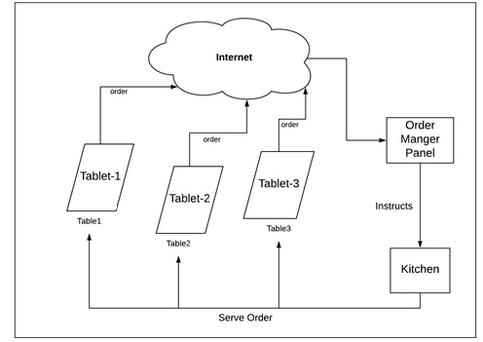
System Architecture
Sri Venkateswara College of Engineering & Technology

Slide 12
MODULES
Customer Interface Modules
Login
Home
Veg and Non-Veg
Item List
Full Item
Cart
Checkout
About-Us
Admin Interface Modules
Add an item
Update an item
Delete an item
Check the order and process it
Generate the bill
Analyses the Sales
Manage offers
Sri Venkateswara College of Engineering & Technology

Slide 13
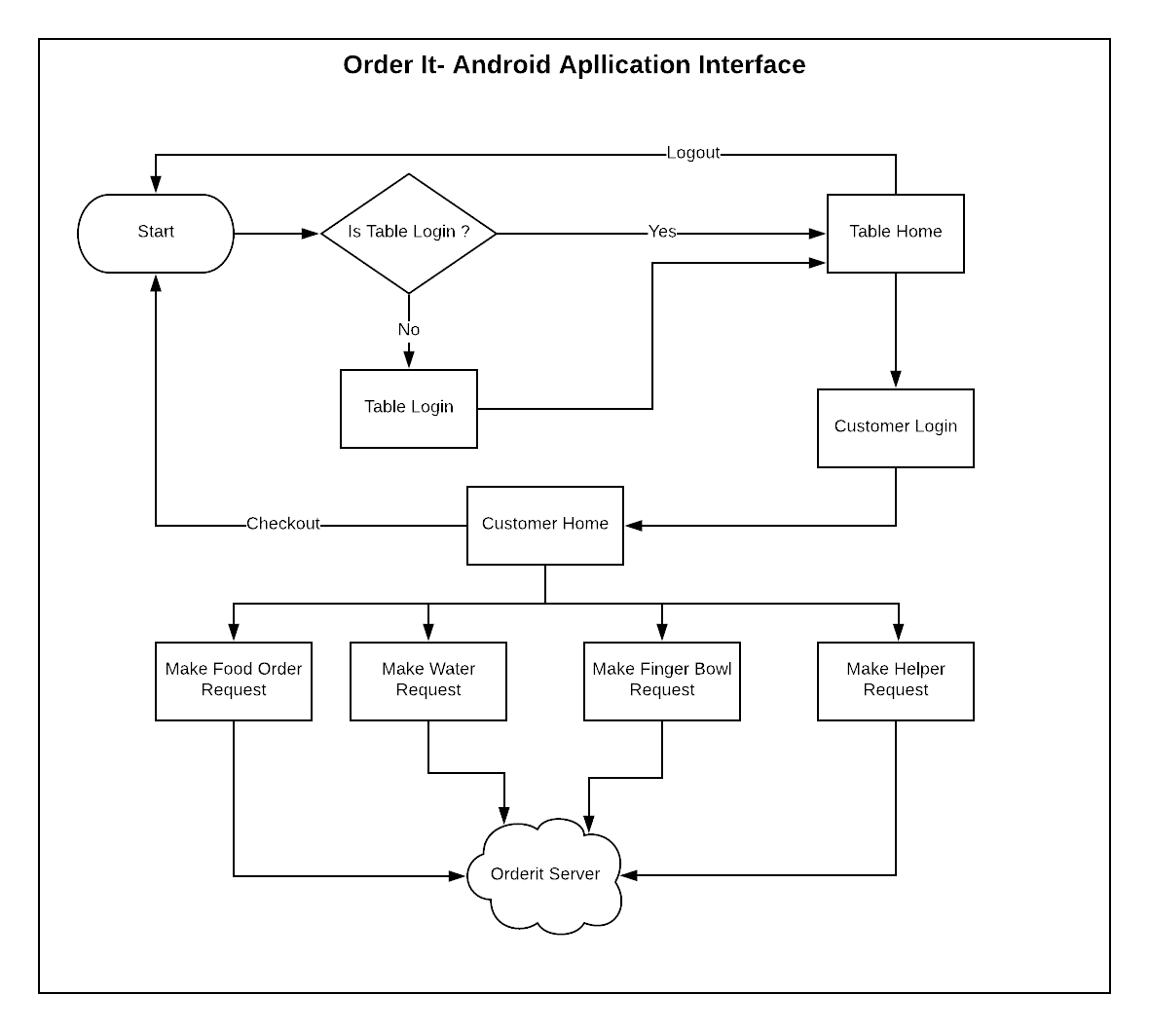
Application Structure
Sri Venkateswara College of Engineering & Technology

Slide 14
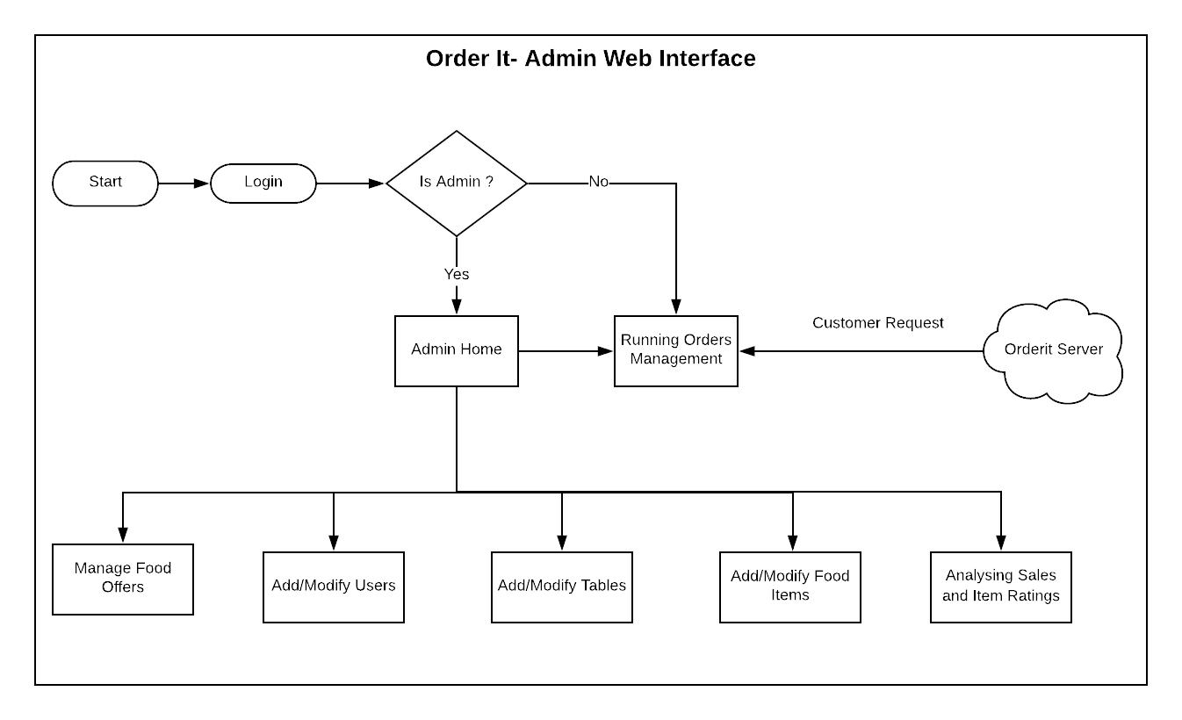
Sri Venkateswara College of Engineering & Technology

Slide 15
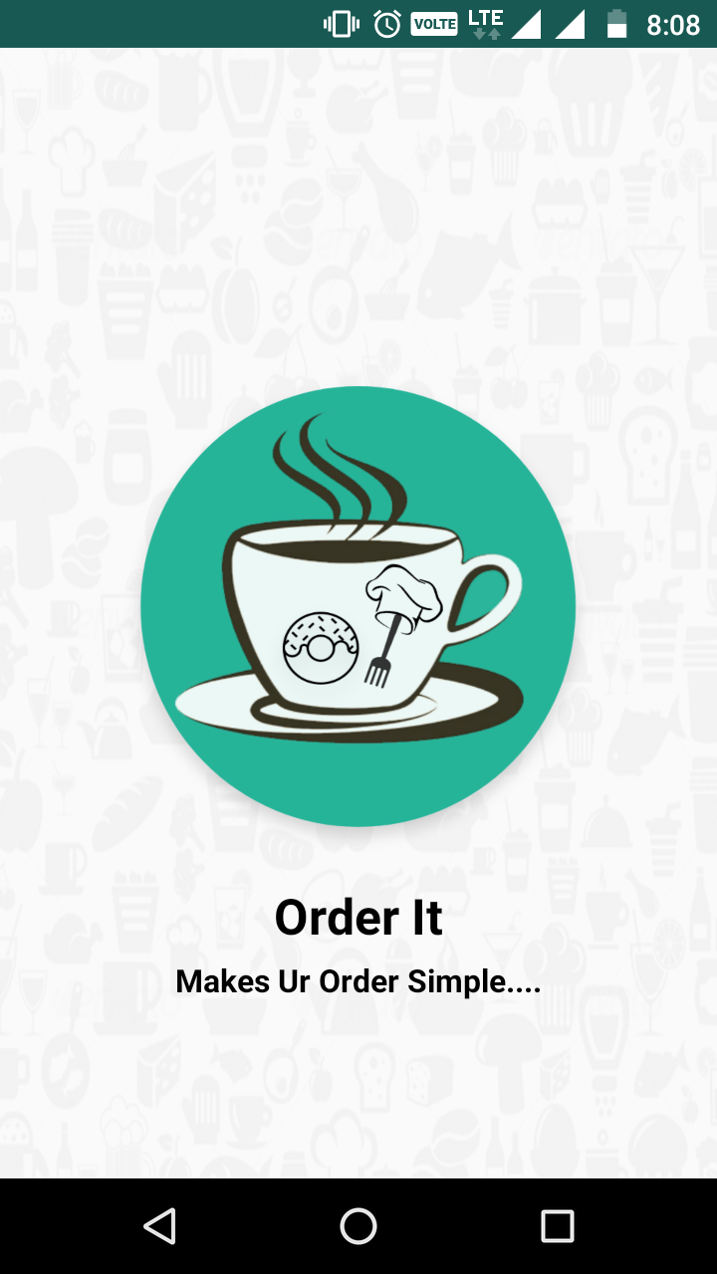
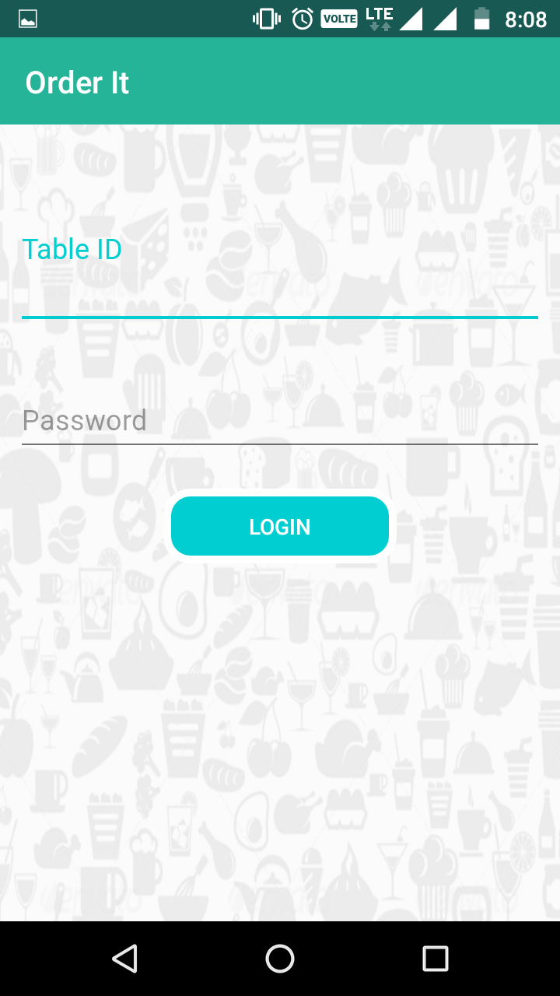
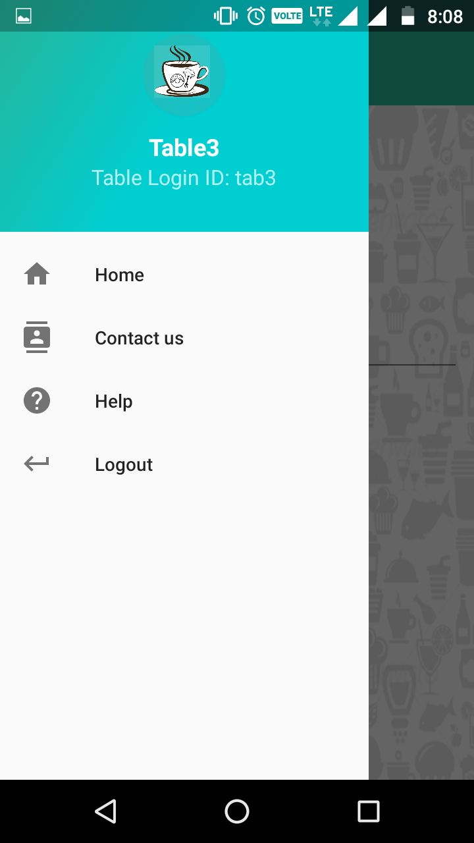
Screenshots
Sri Venkateswara College of Engineering & Technology

Slide 16
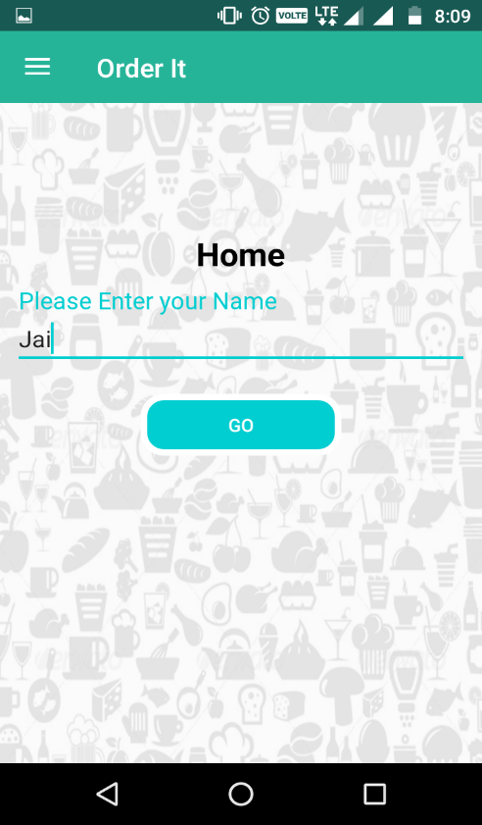
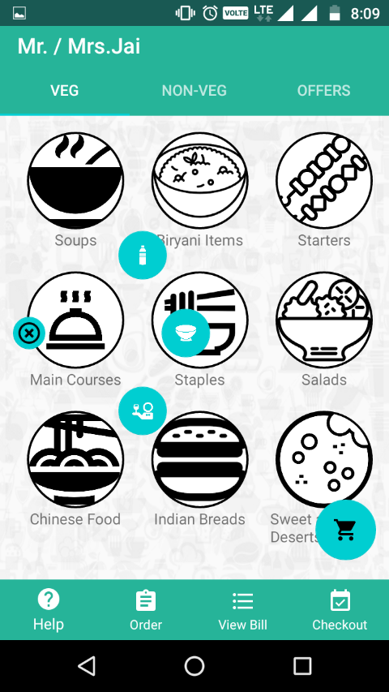
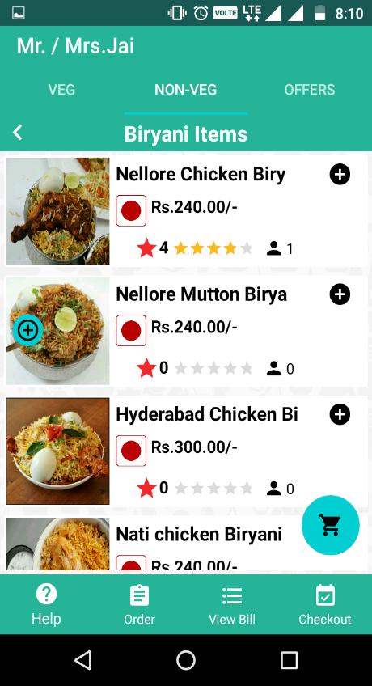
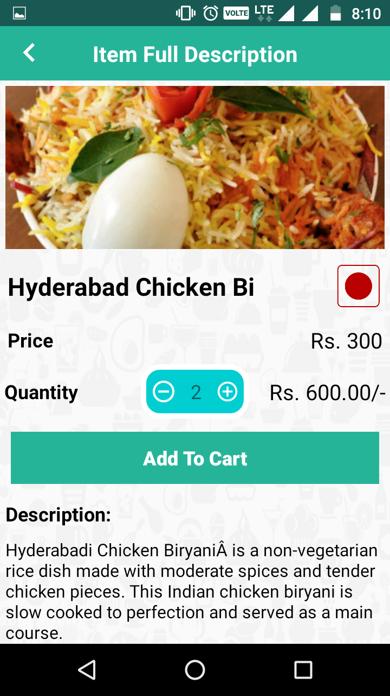
Screenshots
Sri Venkateswara College of Engineering & Technology

Slide 17
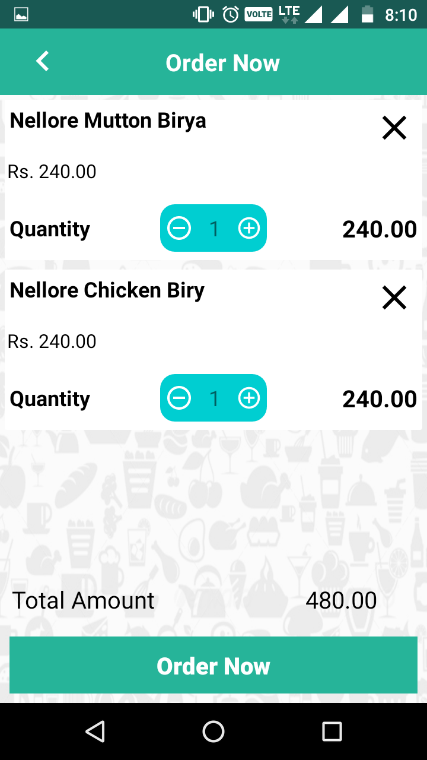
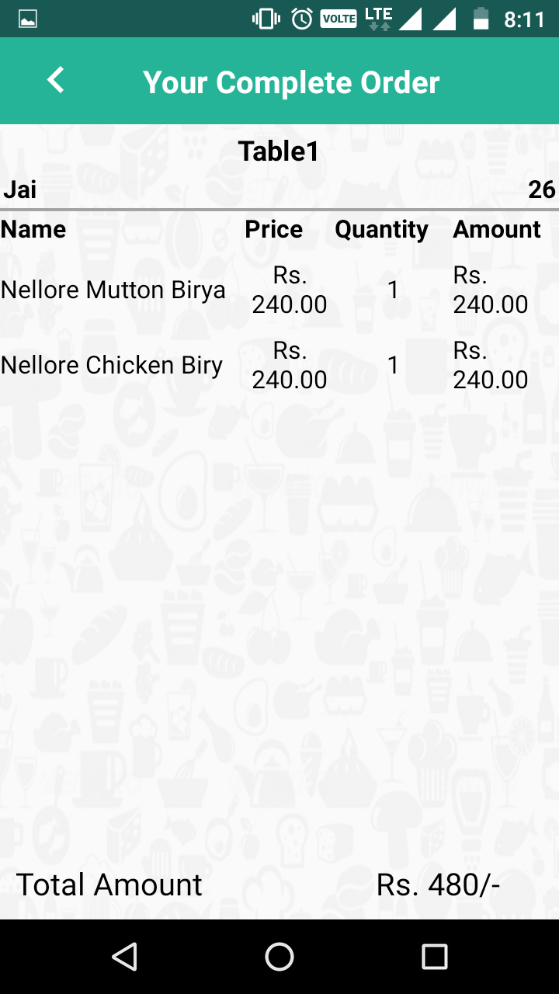
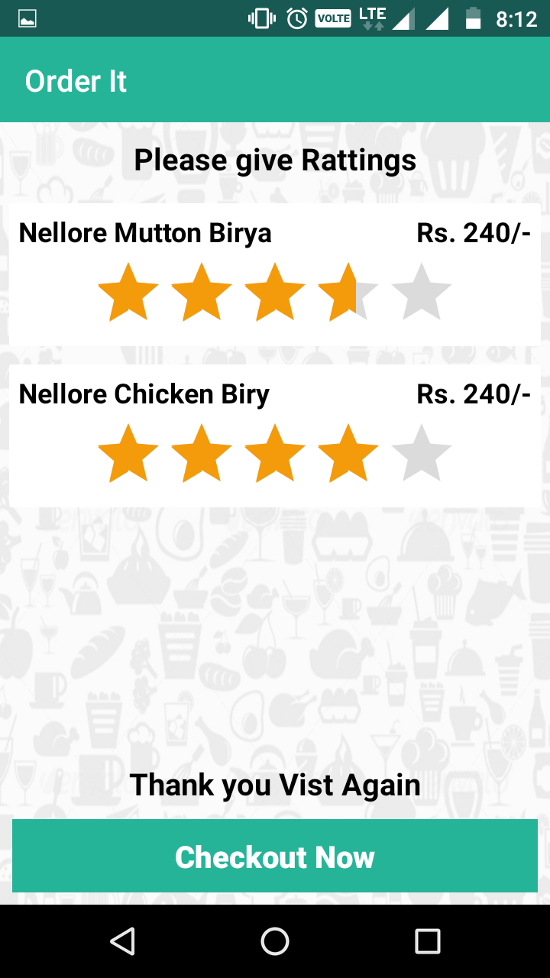
Screenshots
Sri Venkateswara College of Engineering & Technology

Slide 18
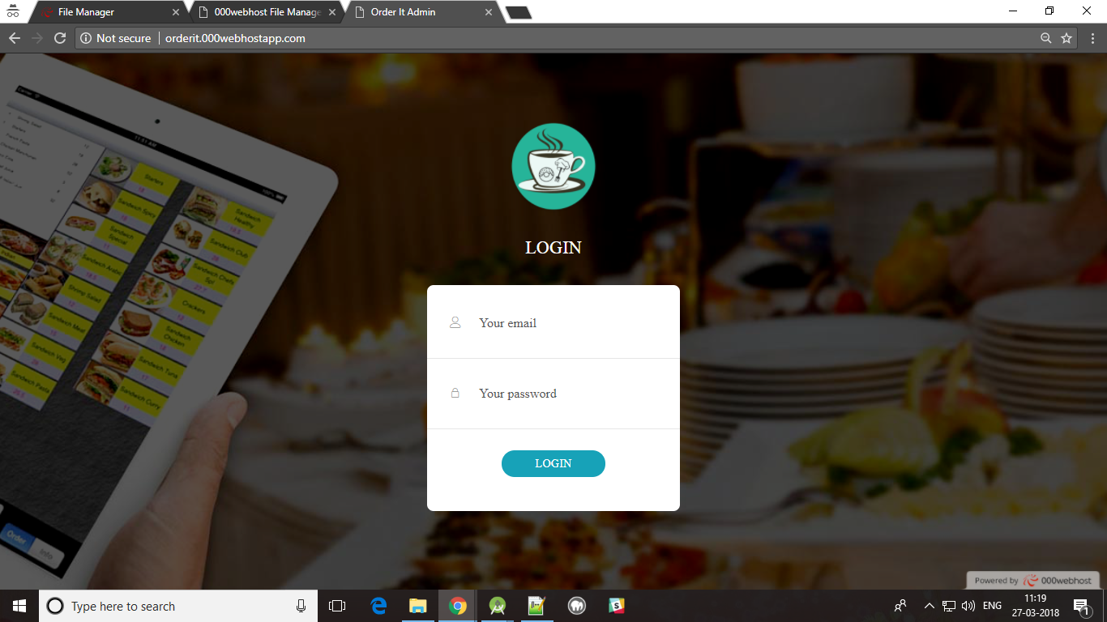
Screenshots
Sri Venkateswara College of Engineering & Technology

Slide 19
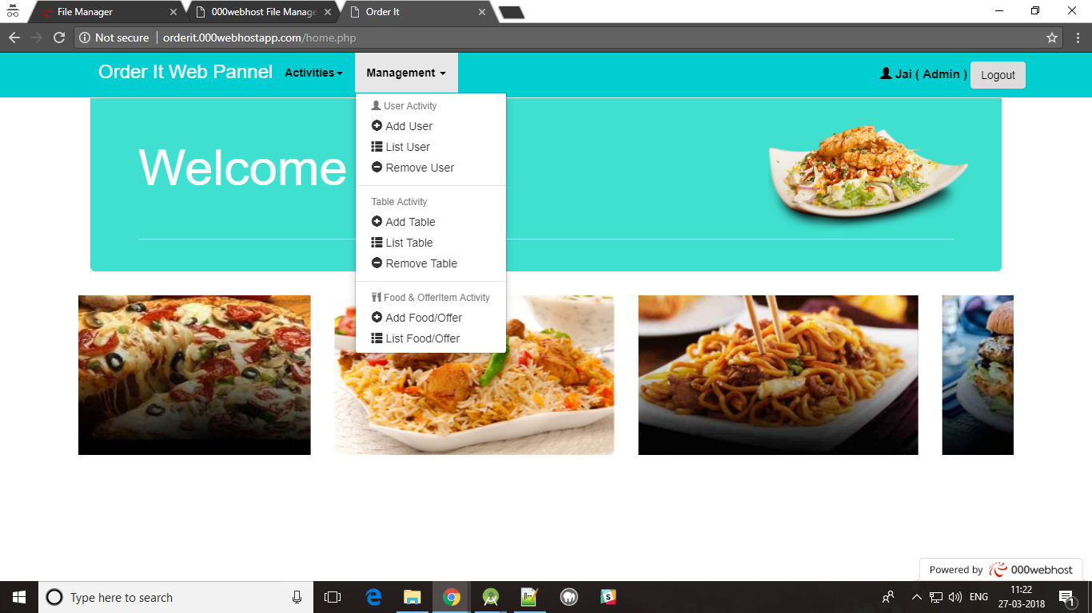
Screenshots
Sri Venkateswara College of Engineering & Technology

Slide 20
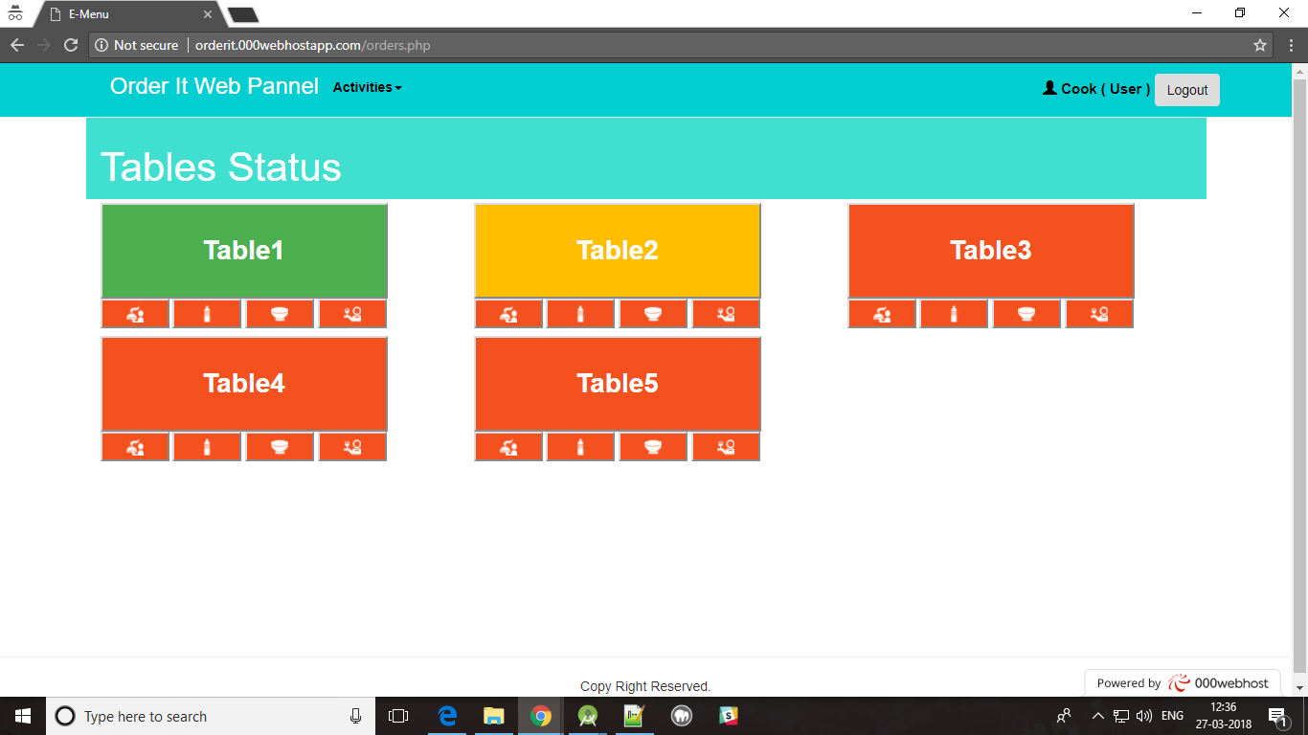
Screenshots
Sri Venkateswara College of Engineering & Technology

Slide 21
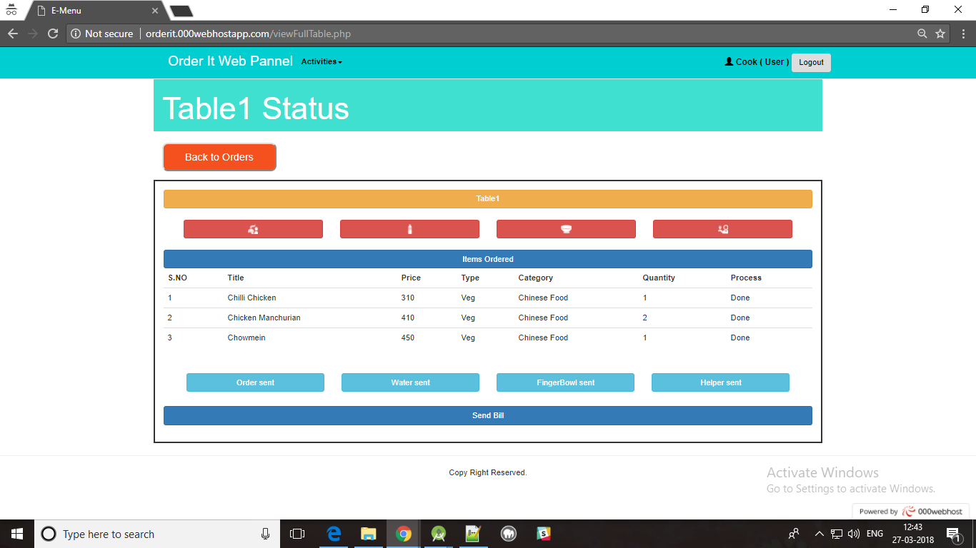
Screenshots
Sri Venkateswara College of Engineering & Technology

Slide 22
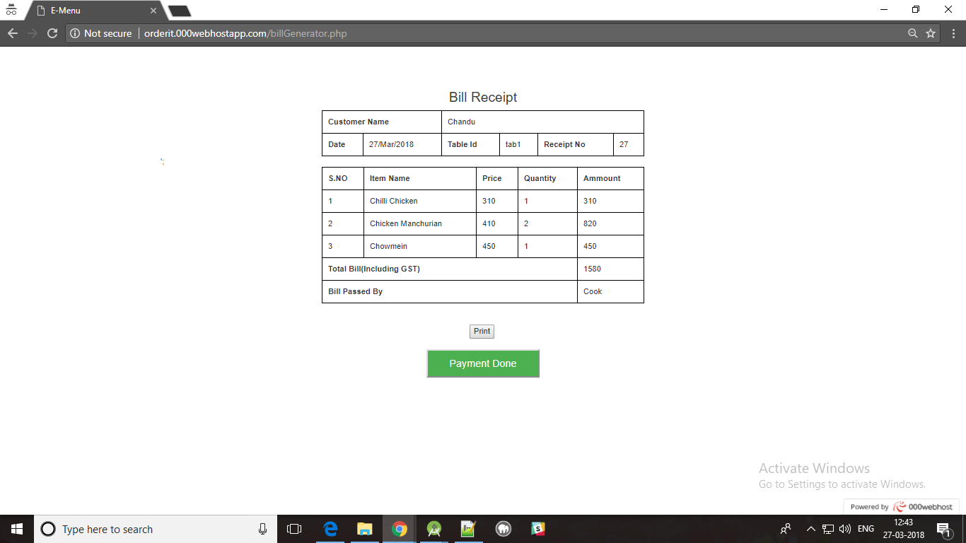
Screenshots
Sri Venkateswara College of Engineering & Technology

Slide 23
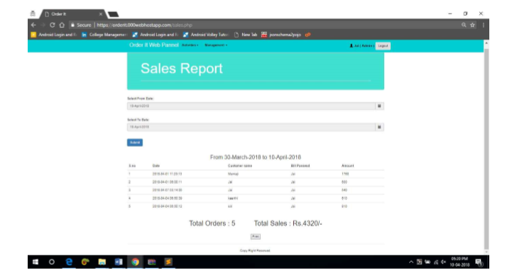
Screenshots
Sri Venkateswara College of Engineering & Technology

Slide 24
Future Enhancement
Currently, this application is working with the functionality like replacing menu cards, can be extended with online payment gateway for the ordered food.
This app can be used for food sales report if the restaurant have many branches.
It can make the order environment completely digitalized. And this application has a flexibility to change as per the client requirements as it is private app.
Rating analysis can also be enhanced in this application using statistical algorithms to make restaurant management to easily analyze their business.
Sri Venkateswara College of Engineering & Technology

Slide 25
Conclusion
• 100% digitized process for ordering food.
• Efficient estimation of food order based on budget.
• Instead of waiter or server this Order It will help you.
• Order It integrates with your POS system, sending orders straight from customer to kitchen and creating a seamlessly integrated platform for both the user and you.
Sri Venkateswara College of Engineering & Technology

Slide 26
THANK YOU

